Slide 1
TEAM CUATRO

Slide 2
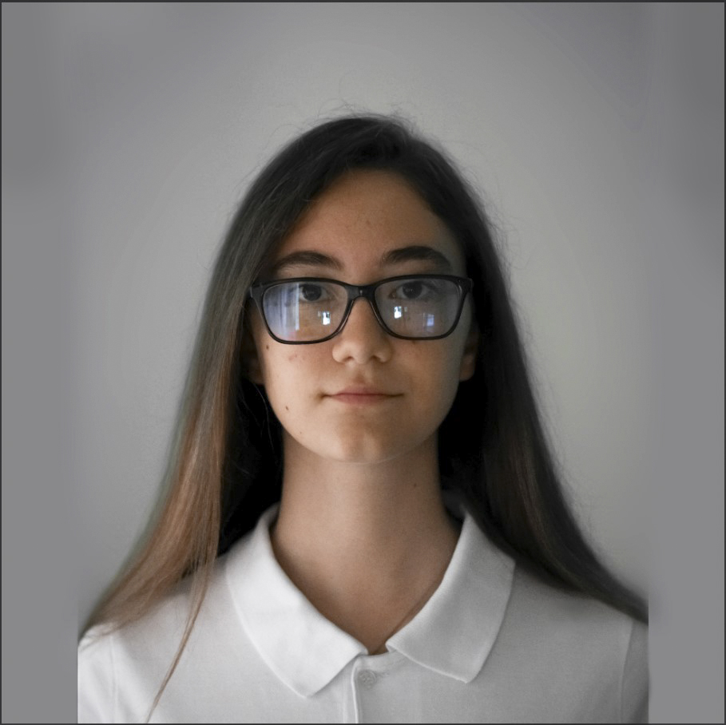
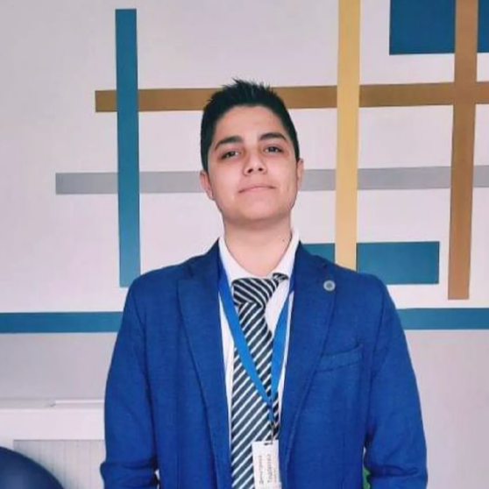
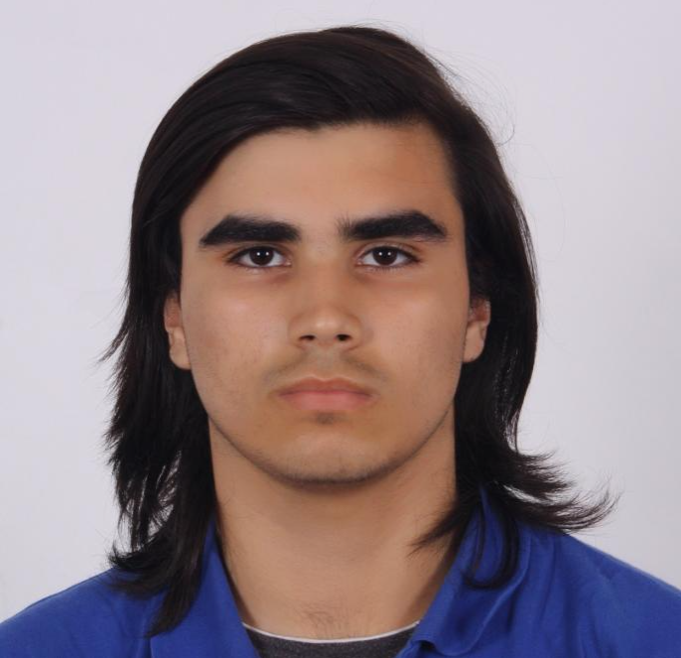
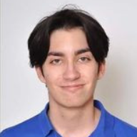
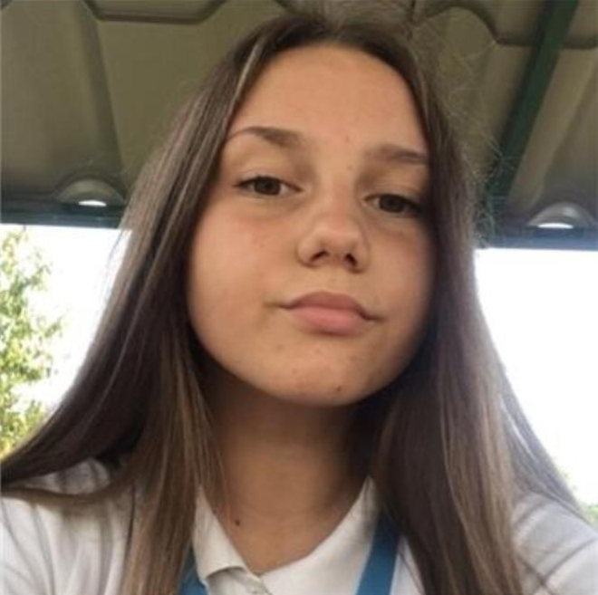
OUR TEAM
Aleksandra Staykova Leader & Deployment Developer
Hristo Kovachev Crawler Developer
Daniel Georgiev Django Developer
Georgi Vasilev Django Developer
Karina Tangardzhieva AI, ML Developer

Slide 3
TASK

Slide 4
STAGES OF DEVELOPMENT
01
O2
03
Finding eachother
Starting work
Finishing the project

Slide 5






USED TECHNOLOGIES

Slide 6
Let’s jump to our project!
or at least what we have done

